Slide 1

The Debt Book Group 40
201801505 Cuong Nguyen
201610981 Danny Tran
201506554 Nina Nguyen
201607649 Stanie Cheung

Slide 2
Architectural Patterns
MVVM (Model-view-viewmodel)
MVP (Model-view-presenter)
MVC (Model-view-controller)

Slide 3
Design Choice
Separation of concerns
Testability
Low coupling

Slide 4
MVVM
Model: Like MVC and MVP, it holds the data and contains the business logic
View: Responsible for both showing the Model and initial handling of user input
ViewModel: holds the View’s state and contains the presentation logic

Slide 5
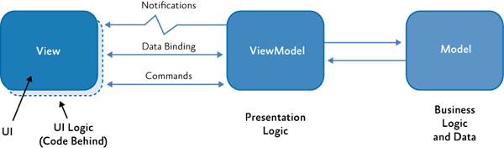

Slide 6
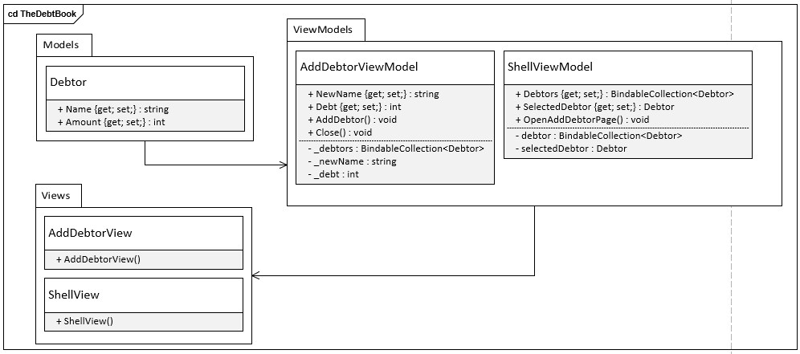
Class Diagram

Slide 7
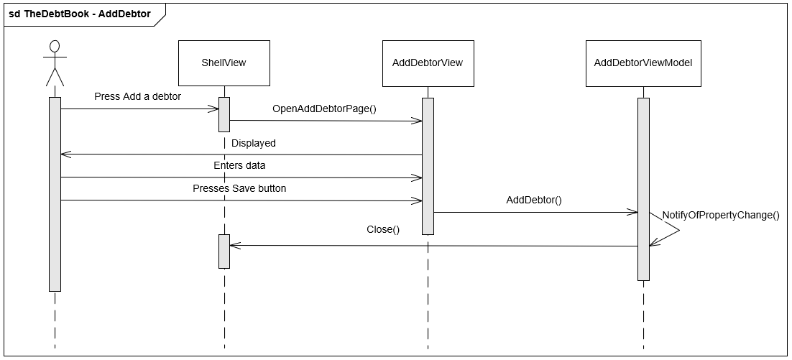
Sequence Diagram – Add a debtor

